Slide 1

Robotic Surgeries
Jasper Eng

Slide 2
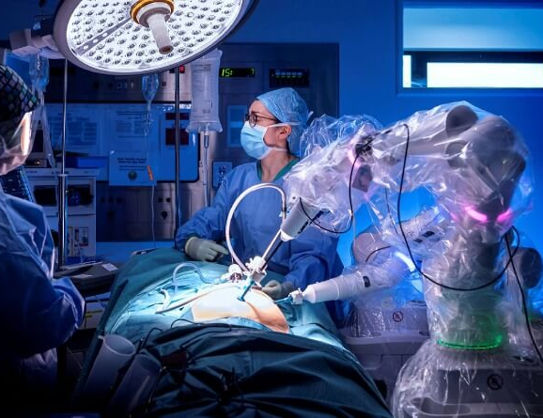
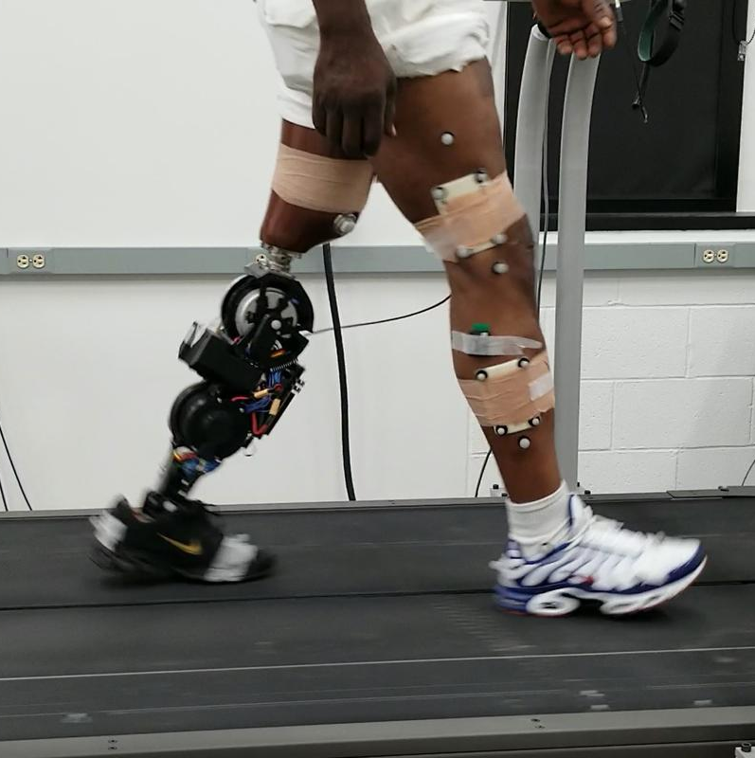
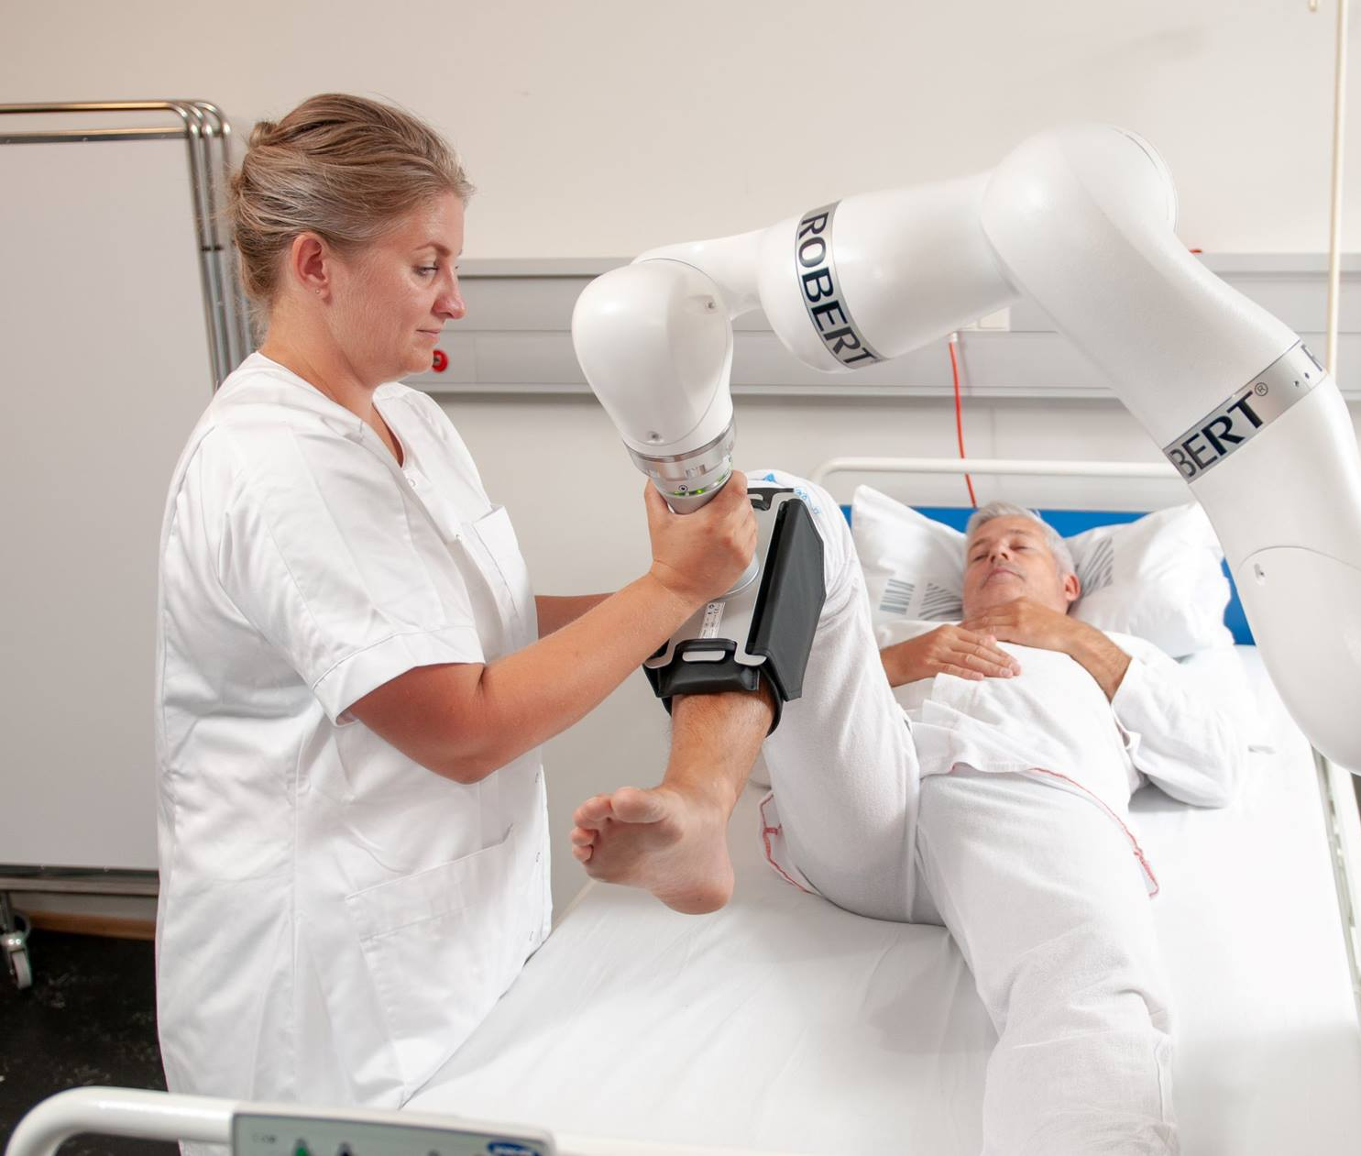
How Can Robots Help US?
Robotic Surgeries
Robot-Assisted Rehabilitation
Robotic Prosthesis

Slide 3
What is Robotic Surgery
Robotic surgery can take many forms
The most common robotic based surgeries are minimally invasive surgeries (MIS)
Robotic surgeries can also involve robots doing traditional open surgical procedures
Often require surgeon operators to control the bot
Utilize a wide array of sensors, and tools

Slide 4
Benefits of Robotic Surgery
Robots can achieve sub-millimeter precision
Teleoperated robots allow highly skilled surgeons to operate remotely
New ways to achieve the same tasks (joint configurations)
Less invasive surgeries leading to faster recoveries

Slide 5
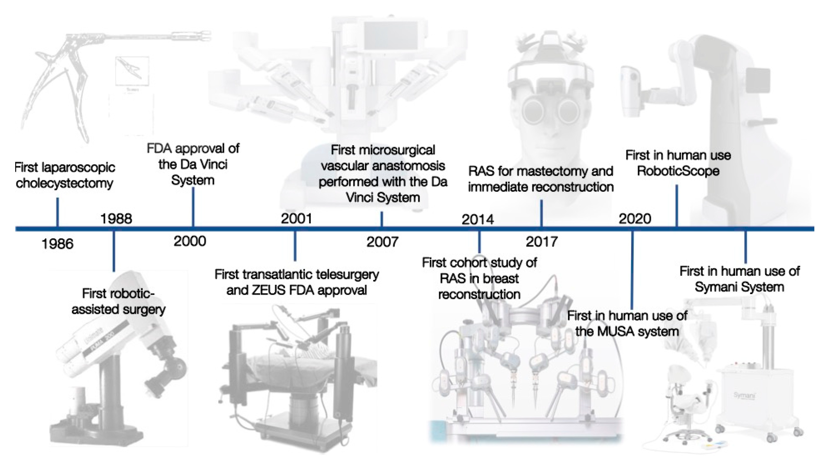
Evolution of Robots in Surgery

Slide 6
Current Robotic Surgical Systems
Da Vinci robot
3 DoF*
3D HD display
Worldwide use
Hugo robotic‐assisted surgery system
VR, with HD video and Haptic feedback
Training
Enos single access robotic surgical system
25 mm insertion tube
3D HD display
2 articulating flexible arms
7 DoF arms

Slide 7
Challenges and Limitations
Accessibility
Costs
Increased time for operations
Redesigning of Current operations
Large oversized
Approval from governing bodies

Slide 8
Questions?

